Slide 1
FCE Bootcamp – March 2017 Application Architectures Week Stream Processing
Jeremy Beard | Principal Solutions Architect

Slide 2
Stream processing
Automated ingest and transformation that is always running
Usually from a queue of some kind
Usually for events that have just happened in the real world
“Real” streams vs. micro-batches
Streams operate on each record as they arrive
Micro-batches operate on all records that have very recently arrived
For many use cases the difference is negligible

Slide 3
Flume
Stream ingestion component
Runs as agents that are always listening
Records are processed individually
Records arrive from a source (e.g. syslog, jms, kafka)
Records are buffered in a channel (e.g. disk, memory, kafka)
Records are sent out to a sink (e.g. hdfs, hbase, kafka)
Interceptors allow inserting light custom code

Slide 4
Kafka
Publish-subscribe system
Runs as a cluster of brokers
Messages are held in topics
Topics can be partitioned
Topics can be replicated
Every message has a strictly-ordered offset in a partition

Slide 5
Spark Streaming
Stream processing module for Spark
Processes arriving records in micro-batches
Typically 1 to 10 seconds
Each micro-batch is an RDD that you can process as if it was a full batch
Envelope is a project I wrote to develop Spark Streaming pipelines without code
github.com/cloudera-labs/envelope

Slide 6
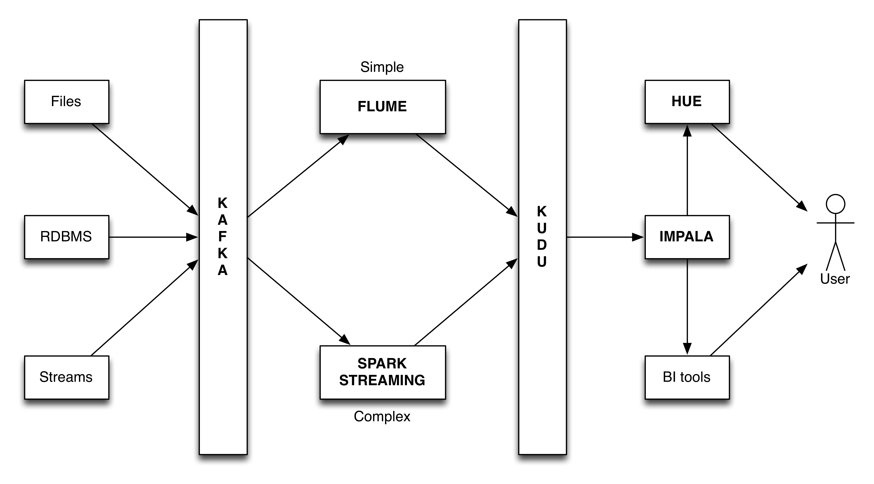
Stream processing architecture vision

Slide 7
Gravity use case
Run measurements stream using the provided data generator
Build a generator -> Flume -> HBase pipeline
Then switch out HBase for HDFS
Build a generator -> Flume -> Kafka -> Spark Streaming -> HBase pipeline
Then switch out HBase for Kudu
First use built-in Spark-Kudu API, then use Envelope
Then switch out Kudu for Solr

